Slide 1
P R A O F
Polynomial Regression and Over-Fitting

Slide 2
Polynomial Regression and Overfitting
Overfitting is "the production of an analysis that corresponds too closely or exactly to a particular set of data, and may therefore fail to fit additional data or predict future observations reliably".
Overfitting a model is a condition where a statistical model begins to describe the random error in the data ( i.e. noise) rather than the relationships between the variables.
This occurs when you try to estimate too many parameters from the sample. Each term in the model forces the regression analysis to estimate a parameter using a fixed sample size.
Therefore, the size of your sample restricts the number of terms that you can safely add to the model before you obtain erratic estimates.
Source: Wikipedia & statisticsbyjim.com

Slide 3
Polynomial Regression and Overfitting
Polynomial regression can be prone to overfitting because the higher the degree of the polynomial the more likely the model is to be overfitted, or, the more degree you add to the polynomial, the better the fit to the training data is.
In regression analysis overfitting can produce misleading r-squared values, regression coefficients, and p-values.
It is often difficult to interpret the individual coefficients in a polynomial regression fit, since the underlying monomials can be highly correlated.
Source: Wikipedia & statisticsbyjim.com

Slide 4
Polynomial Regression and Overfitting
To detect overfitting you compare the predicted r-squared to the regular r-squared to determine if there is a big difference. If there is your model doesn’t predict new observations as well as it fits the original dataset. This means you are likely overfitting the model.
To avoid overfitting a regression model, you should draw a random sample that is large enough to handle all of the terms that you expect to include in your model.
Further reading : http://enhancedatascience.com/2017/06/29/machine-learning-explained-overfitting/

Slide 5
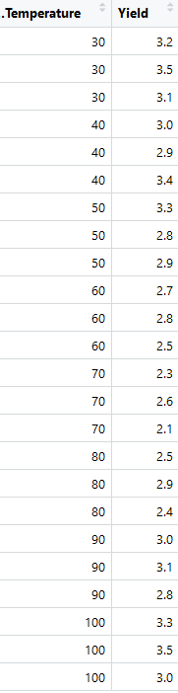
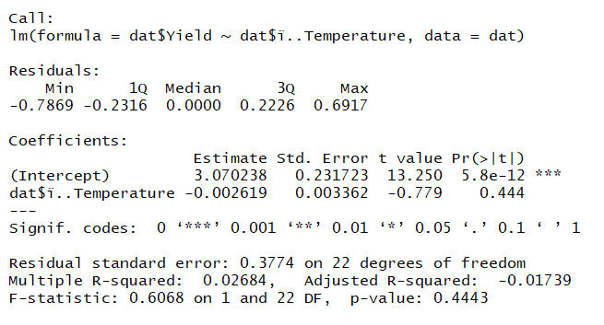
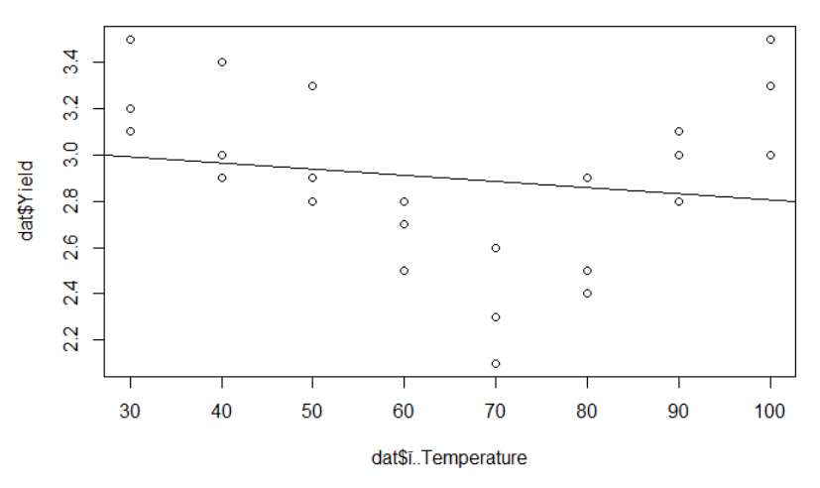
Polynomial Regression and Overfitting
Data Set
Linear model
Plot with linear model
This model would be considered significantly underfitted
Notes:
R-Squared is very small, as the graph shows a linear model is not sufficient.

Slide 6
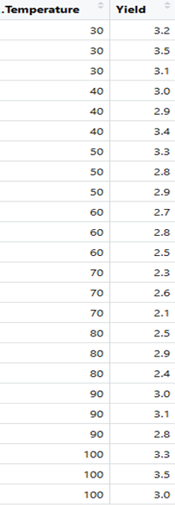
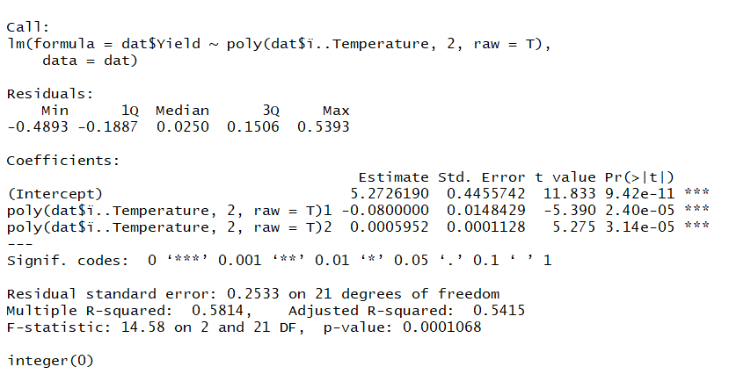
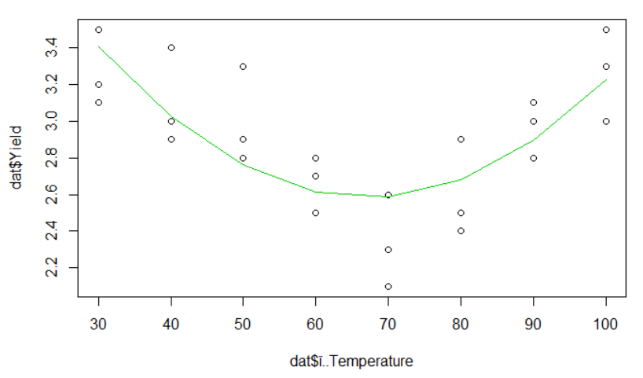
Fitting a Polynomial Regression Model
Same Data
Polynomial model (x^2)
Plot with squared polynomial model
Considered a good/robust fit
Notes:
Good fit because:
the std. error is small, even when you consider the fact the coefficients are even smaller.
P-values are small, which means that we can conclude that there is a relationship between temperature and yield under this model.
R squared above .5 is good, and the residual error is low

Slide 7
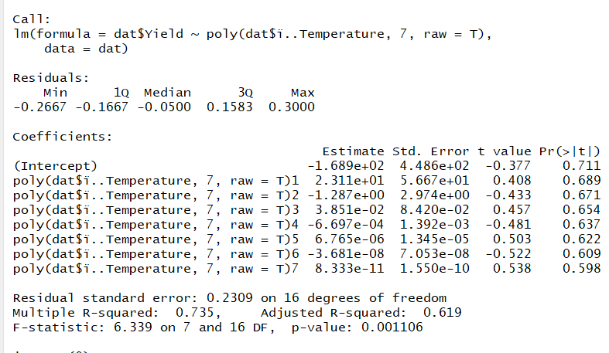
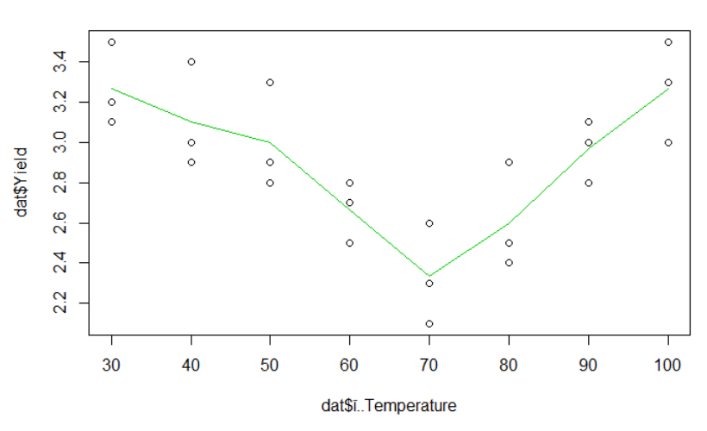
Fitting a Polynomial Regression Model
Same Data
Polynomial model (x^7)
Plot with x^7 polynomial model
Model is overfitted

Slide 8
Overfitting - Conclusions
We saw a low degree leads to underfitting. A natural conclusion would be to learn the data, we should just increase the degree of the model to capture every change in the data. This however is not the best decision…
While this would be acceptable if the observations perfectly represented the true function, because there is noise in the data, our model ends up fitting the noise. This is a model with a high variance, because it will change significantly depending on the training data. The higher degree model is still better than the one degree model, but higher degree model still does not learn the relationship because it essentially memorizes the data and its noise.
With such a high degree of flexibility, the model does its best to account for every single training point. This might seem like a good idea — don’t we want to learn from the data? Further, the higher degree model has a high R-squared because it gets close to all the points.

Slide 9
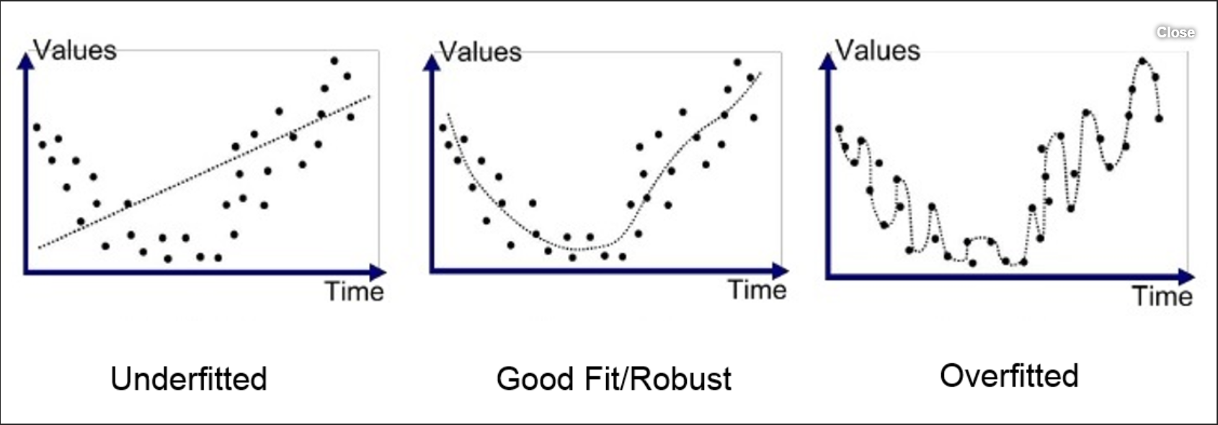
Visualizing Underfitting and Overfitting

Slide 10
L R A O
Linear regression and outliers

Slide 11
How do outliers affect regression models?
Outliers
Leverage
Influence
3 Somewhat Overlapping Types of Extreme Observations
Source: ‘The Book of R’ by Tilman Davies

Slide 12
Outliers
An observation with a large residual – unusual in the context of the data. Considered an outlier only if it doesn’t conform to the trend of the fitted model. Can, but doesn’t always alter the overall trend of the fitted model.
Leverage
An observation is a high-leverage point if it is extreme enough to potentially affect the slope of the fitted model. An outlier can have high or low leverage.
Influence
An observation is classified as influential if it has high-leverage and does affect the estimated trend.
Source: ‘The Book of R’ by Tilman Davies

Slide 13
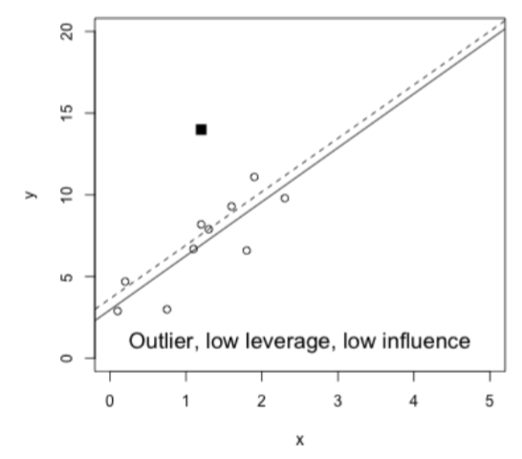
Outlier with Low-Leverage & Low-Influence:
Outlier since it sits away from most of the data and doesn’t conform to the trend
Low-Leverage because its predictor value (x) isn’t unusual compared to other values of x
Effect of including it in the model would be to basically change the y-intercept
Low-Influence point because the overall change to the fitted model is minimal
Source: ‘The Book of R’ by Tilman Davies

Slide 14
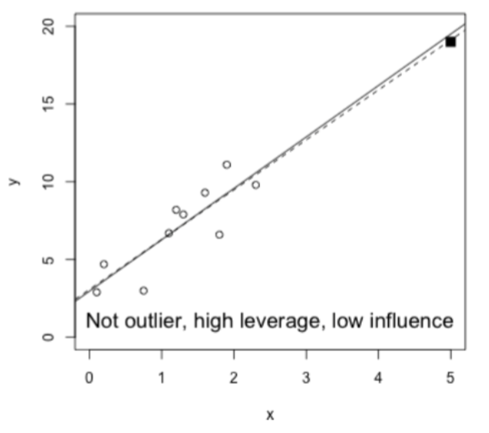
Not Outlier with High-Leverage & Low-Influence:
Not an outlier because although it sits apart from observations, it conforms quite well to model fit
High-Leverage because it sits at extreme predictor value compared to other values of x (has potential to dramatically alter the fit should it’s response value be different.
Low-Influence point because model fit barely affected by its inclusion.
Source: ‘The Book of R’ by Tilman Davies

Slide 15
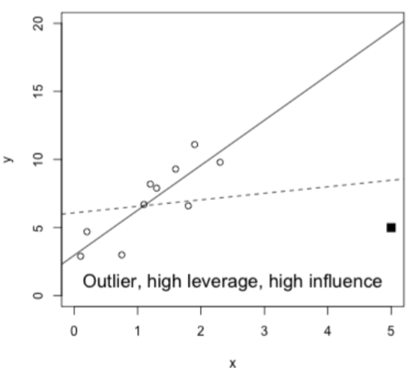
Outlier with High-Leverage & High-Influence:
Outlier because it sits away from original observations and isn’t clear part of trend
High-Leverage because it sits at extreme predictor value compared to other values of x (has potential to dramatically alter the fit should it’s response value be different.
High-Influence point because its inclusion substantially alters entire model by dragging down slope and raising the y-intercept.
Source: ‘The Book of R’ by Tilman Davies

Slide 16
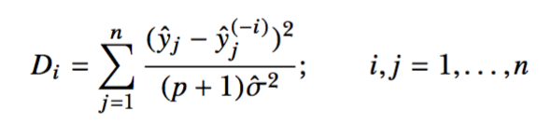
Cook’s Distance
Leverage alone isn’t enough to determine the overall influence of each observation on a fitted model. For that, the response value must also be taken into account.
Arguably the most well-known measure of influence is Cook’s distance, which estimates the magnitude of the effect of deleting the i^{th} value from the fitted model:
Outlying observations in high-leverage positions will have higher values of D_{i} - D_{i} > 1 (or D_{i} > 4/n with n observations) should be considered influential.
Source: ‘The Book of R’ by Tilman Davies

Slide 17
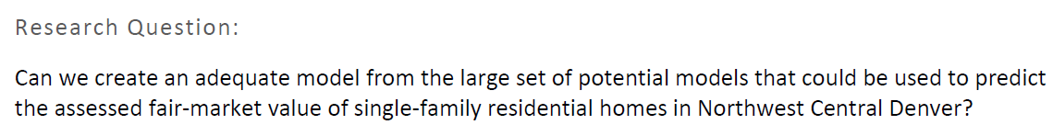
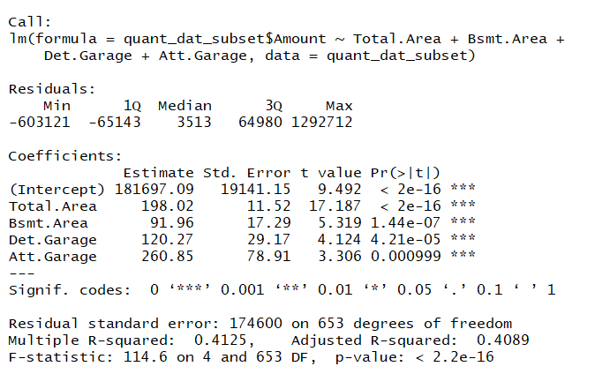
MLR with Outliers
Outliers:
3 lots with no physical improvements, with a sale price of $1,675,000
Model equation:
Y=198.02(total area)+91.96(Bsmt. Area)+120.27(Det. Garage)+260.85(Att. Garage)+181697
R-Squared Value = .4089

Slide 18
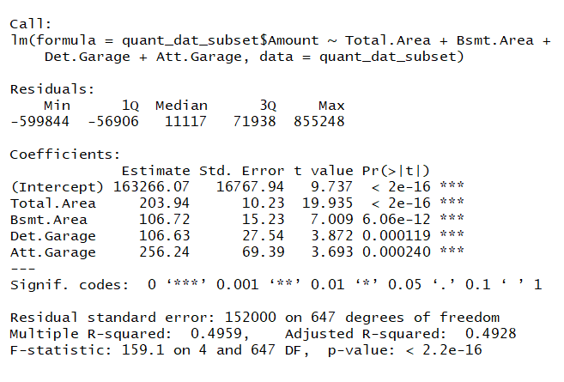
MLR with Outliers Removed
Model equation:
Y=203.94(total area)+106.72(Bsmt. Area)+106.63(Det. Garage)+256.24(Att. Garage)+163266.07
R-Squared Value = .4928
Notes:
When outliers are removed, the R-squared value goes up, meaning that we are more confident in the model’s ability to predict the value of homes in the highlands. The model itself also changed.

